Slide 1
Learning Intentions & Success Criteria 8/3/24
LI
SC
* Examine urban settlements, rural areas and remote areas.
* Examine ways to improve liveability.
Outline what an urban settlement, rural area and remote area are.
Outline ways to address problems in cities (urban settlements).

Slide 2
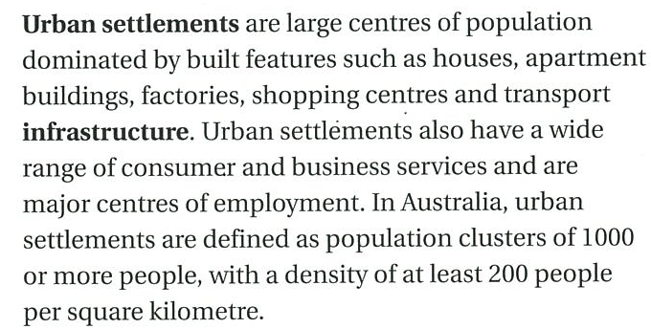


Slide 3
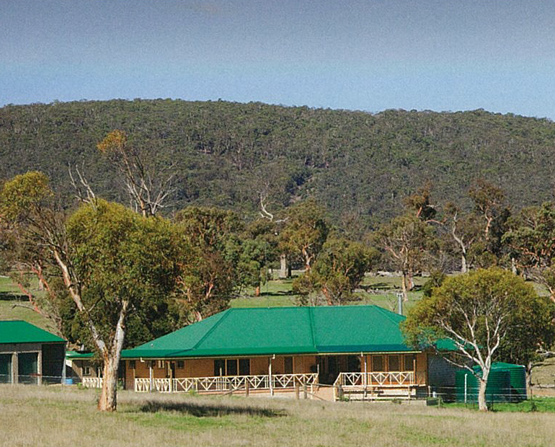
Rural areas are centres of agriculture and provide a small range of goods and services. There are two types: clustered and dispersed.

Slide 4
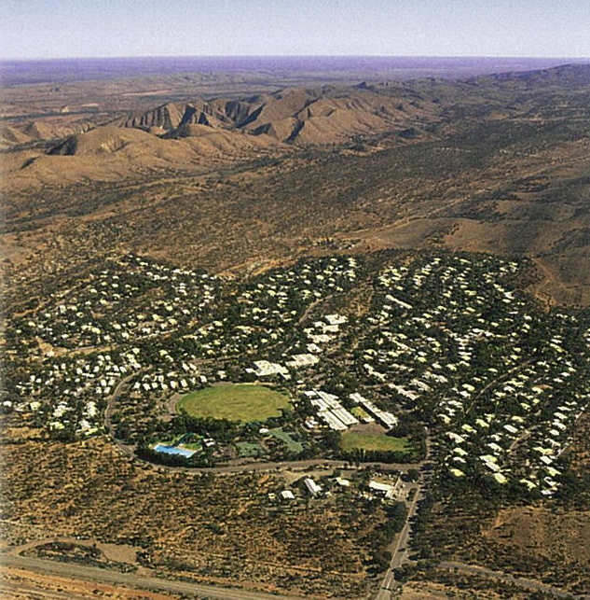
Remote areas are those places that are a long way away (isolated) from the main centres of population. E.G. Australia’s mining communities.

Slide 5
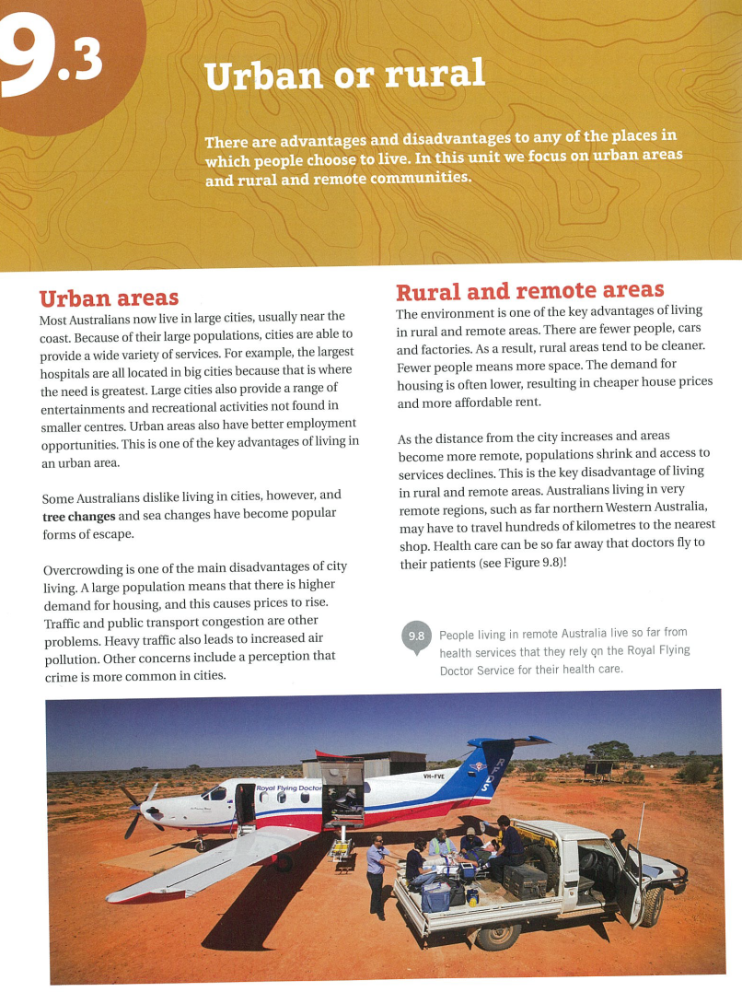
TASK

Slide 6
YOUR TASK
Use reading strategies:
Underline new vocabulary
Highlight key words
Identify key dates and people – circle them

Slide 7


YOUR TASK
Urban
Rural
Remote
Complete the chart to show the advantages and disadvantages of living in each of the three areas:
Try to think of 3 for each
 | Urban | Rural | Remote

Slide 8
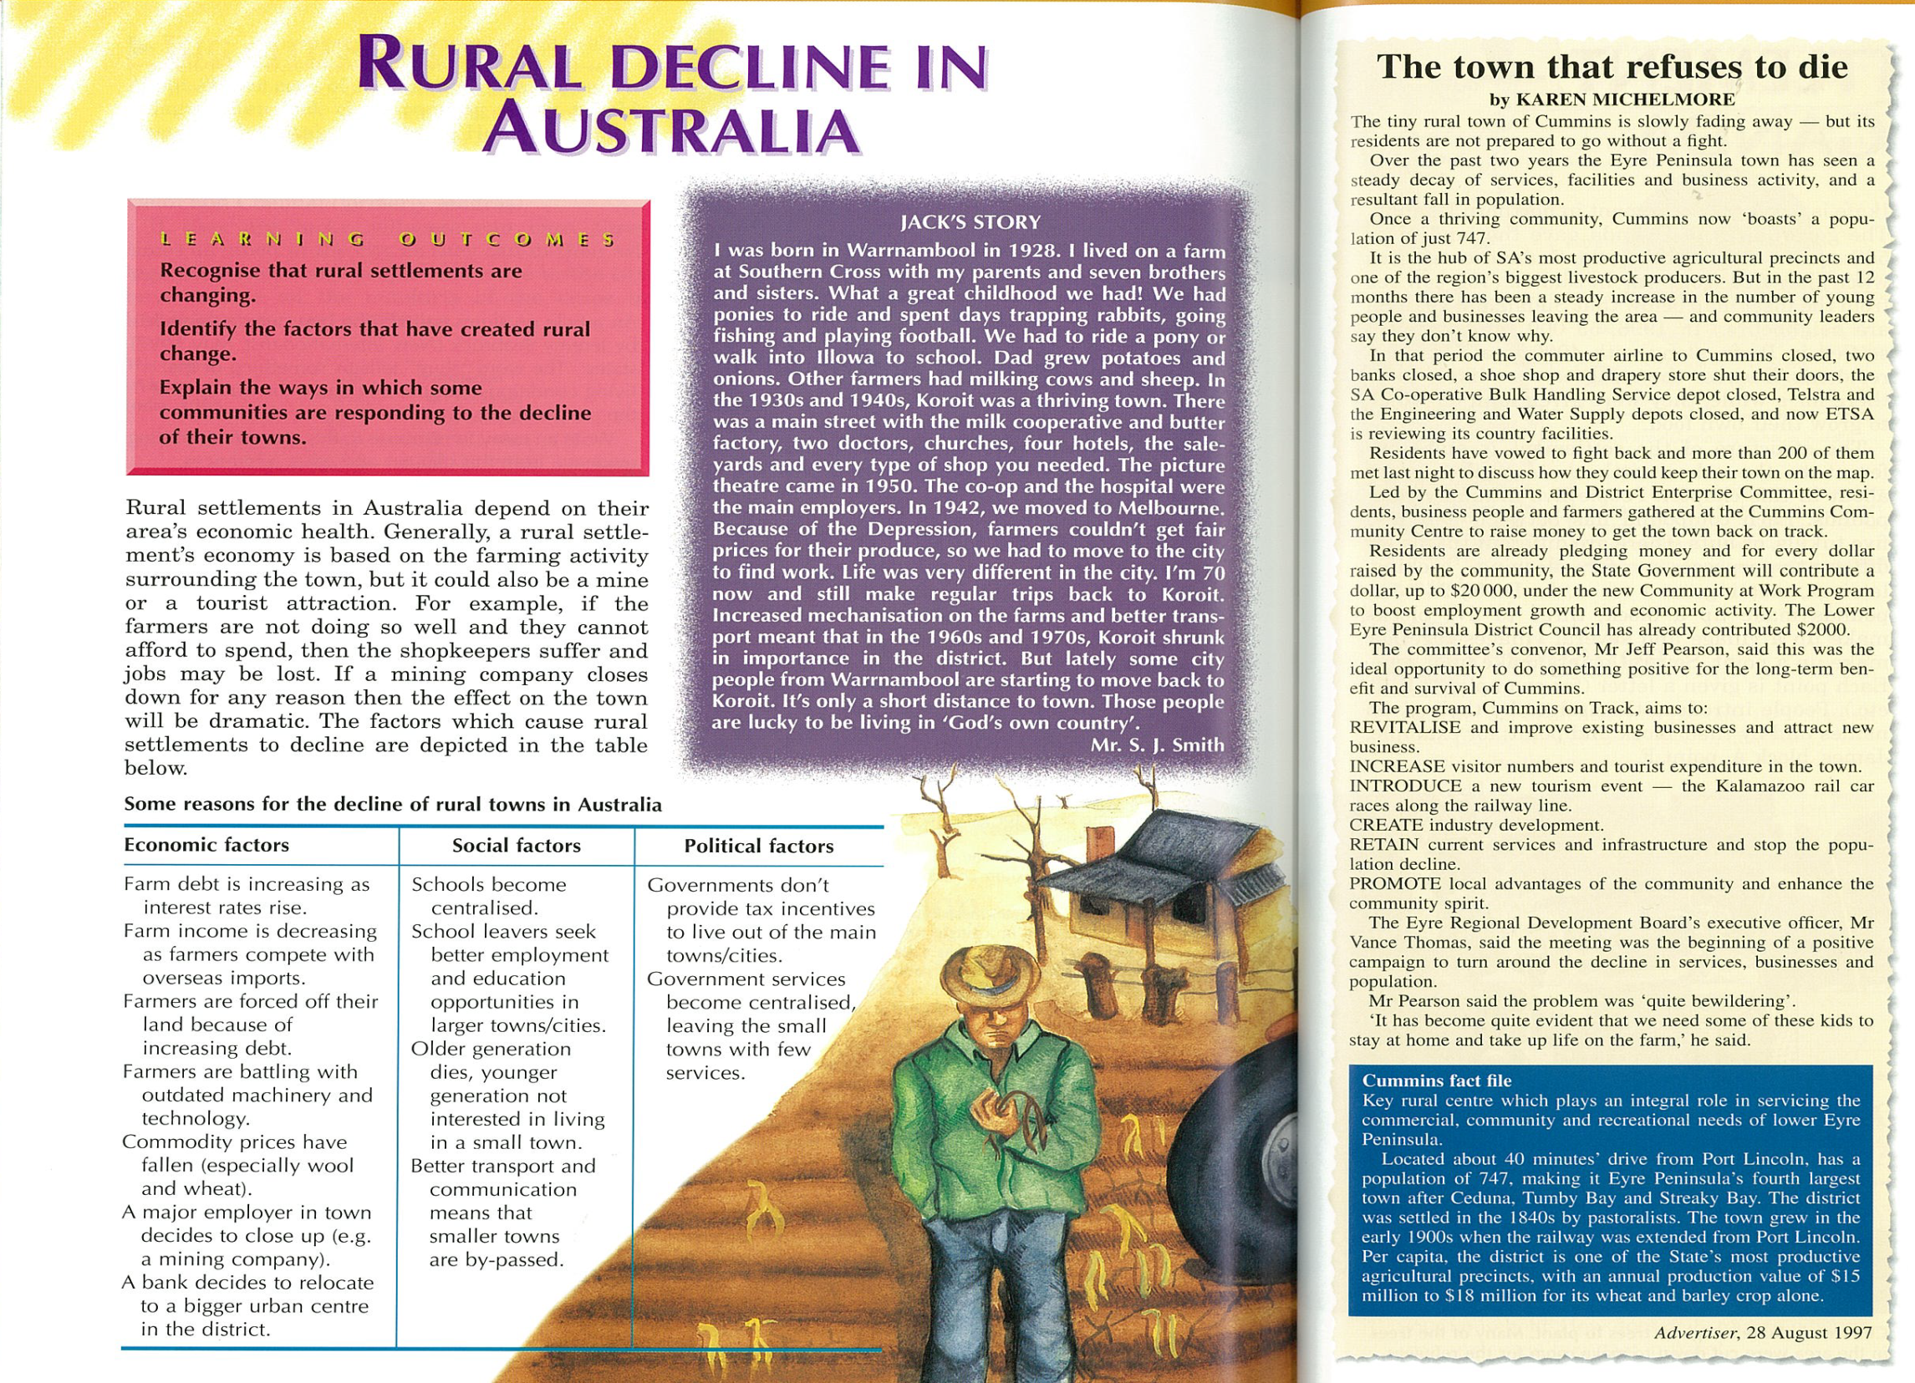


Slide 9

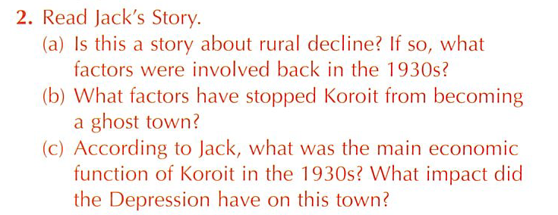

Write

